Slide 1

Chapter 7
Sampling
Distributions

Slide 2
Objectives
In this chapter, you learn:
The concept of the sampling distribution
To compute probabilities related to the sample mean and the sample proportion
The importance of the Central Limit Theorem

Slide 3
Sampling Distributions
DCOVA
A sampling distribution is a distribution of all of the possible values of a sample statistic for a given sample size selected from a population.
For example, suppose you sample 50 students from your college regarding their mean GPA. If you obtained many different samples of size 50, you will compute a different mean for each sample. We are interested in the distribution of all potential mean GPAs we might calculate for any sample of 50 students.

Slide 4



Developing a Sampling Distribution
DCOVA
Assume there is a population …
Population size N=4
Random variable, X,
is age of individuals
Values of X: 18, 20,
22, 24 (years)
D
A
B
C

Slide 5
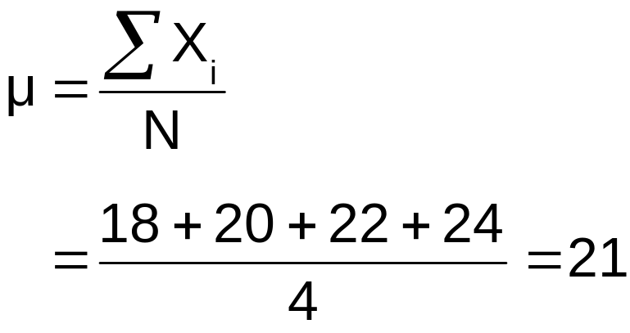
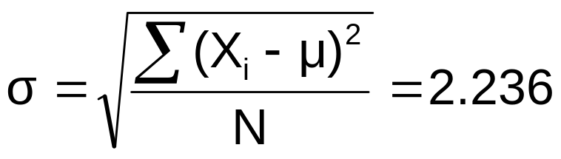
Developing a Sampling Distribution
(continued)
DCOVA
Summary Measures for the Population Distribution:
P(x)
.3
.2
.1
0
18 20 22 24
A B C D
x
Uniform Distribution

Slide 6
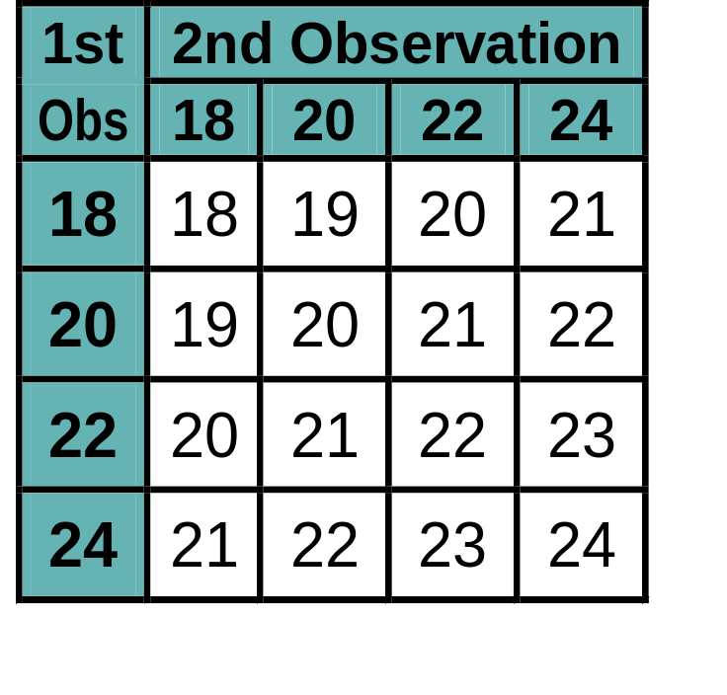
Now consider all possible samples of size n=2
Developing a Sampling Distribution
(continued)
DCOVA
16 Sample Means
1st Obs | 2nd Observation
 | 18 | 20 | 22 | 24
18 | 18,18 | 18,20 | 18,22 | 18,24
20 | 20,18 | 20,20 | 20,22 | 20,24
22 | 22,18 | 22,20 | 22,22 | 22,24
24 | 24,18 | 24,20 | 24,22 | 24,24
16 possible samples (sampling with replacement)

Slide 7

Sampling Distribution of All Sample Means
Developing a Sampling Distribution
(continued)
DCOVA
16 Sample Means
Sample Means Distribution
_
P(X)
.3
.2
.1
0
_
18 19 20 21 22 23 24
X
(no longer uniform)

Slide 8
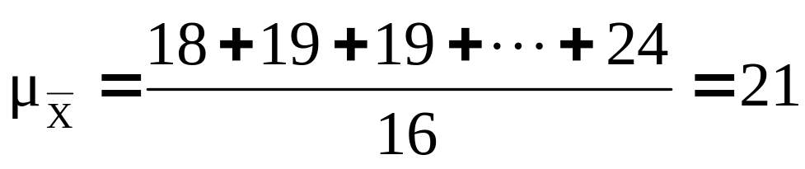
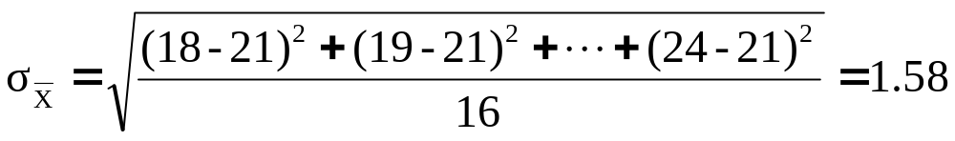
Summary Measures of this Sampling Distribution:
Developing A Sampling Distribution
(continued)
DCOVA
Note: Here we divide by 16 because there are 16
different samples of size 2.

Slide 9
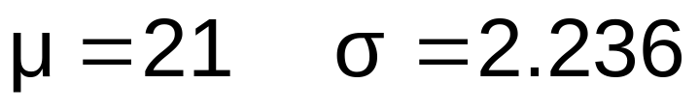
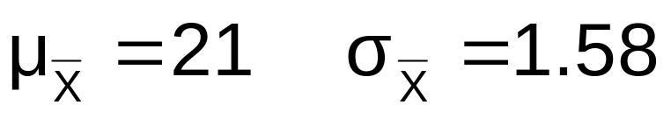
Comparing the Population Distribution to the Sample Means Distribution
DCOVA
Population
N = 4
Sample Means Distribution
n = 2
_
P(X)
P(X)
.3
.3
.2
.2
.1
.1
0
0
_
18 20 22 24
A B C D
X
18 19 20 21 22 23 24
X

Slide 10
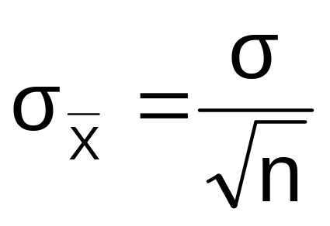
Sample Mean Sampling Distribution:
Standard Error of the Mean
DCOVA
Different samples of the same size from the same population will yield different sample means
A measure of the variability in the mean from sample to sample is given by the Standard Error of the Mean:
(This assumes that sampling is with replacement or
sampling is without replacement from an infinite population)
Note that the standard error of the mean decreases as the sample size increases

Slide 11

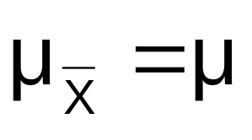
Sample Mean Sampling Distribution:
If the Population is Normal
DCOVA
If a population is normal with mean μ and standard deviation σ, the sampling distribution of is also normally distributed with
and

Slide 12

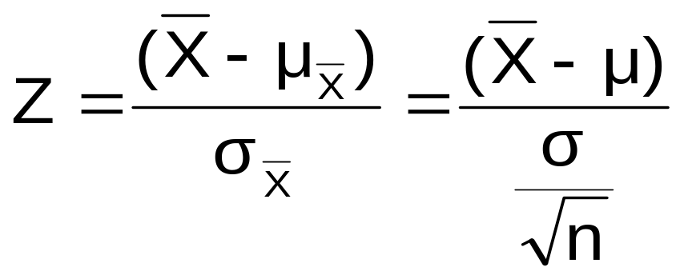



Z-value for Sampling Distribution of the Mean
DCOVA
Z-value for the sampling distribution of :
where: = sample mean
= population mean
= population standard deviation
n = sample size

Slide 13
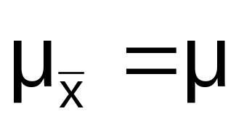


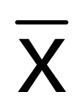

Sampling Distribution Properties
DCOVA
Normal Population Distribution
(i.e. is unbiased )
Normal Sampling Distribution
(has the same mean)

Slide 14
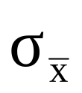

Sampling Distribution Properties
(continued)
DCOVA
  As n increases,
  decreases
Larger sample size
Smaller sample size

Slide 15
Determining An Interval Including A Fixed Proportion of the Sample Means
DCOVA
Find a symmetrically distributed interval around µ that will include 95% of the sample means when µ = 368, σ = 15, and n = 25.
  Since the interval contains 95% of the sample means 5% of the sample means will be outside the interval
  Since the interval is symmetric 2.5% will be above the upper limit and 2.5% will be below the lower limit.
  From the standardized normal table, the Z score with 2.5% (0.0250) below it is -1.96 and the Z score with 2.5% (0.0250) above it is 1.96.

Slide 16
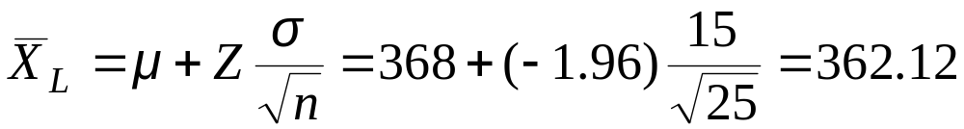
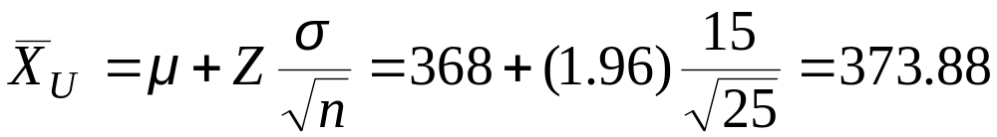
Determining An Interval Including A Fixed Proportion of the Sample Means
(continued)
DCOVA
Calculating the lower limit of the interval
Calculating the upper limit of the interval
95% of all sample means of sample size 25 are between 362.12 and 373.88

Slide 17
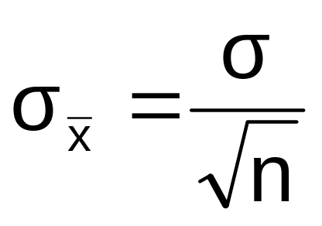
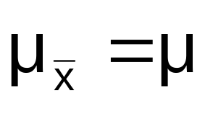
Sample Mean Sampling Distribution:
If the Population is not Normal
DCOVA
We can apply the Central Limit Theorem:
  Even if the population is not normal,
  …sample means from the population will be approximately normal as long as the sample size is large enough.
  Properties of the sampling distribution:
  and

Slide 18
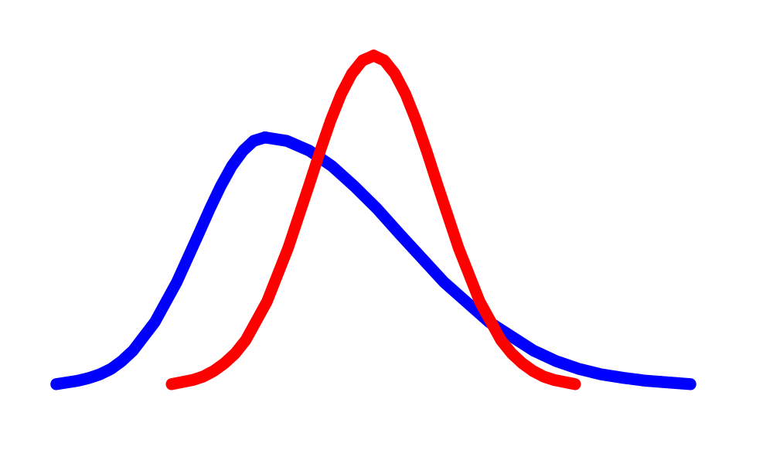
Central Limit Theorem
DCOVA
the sampling distribution of the sample mean becomes almost normal regardless of shape of population
As the sample size gets large enough…
n↑

Slide 19


Sample Mean Sampling Distribution:
If the Population is not Normal
(continued)
Population Distribution
DCOVA
Sampling distribution properties:
Central Tendency
Variation
Sampling Distribution
(becomes normal as n increases)
Larger sample size
Smaller sample size

Slide 20
How Large is Large Enough?
DCOVA
For most distributions, n > 30 will give a sampling distribution that is nearly normal
For fairly symmetric distributions, n > 15
For a normal population distribution, the sampling distribution of the mean is always normally distributed

Slide 21
Example
DCOVA
Suppose a population has mean μ = 8 and standard deviation σ = 3. Suppose a random sample of size n = 36 is selected.
What is the probability that the sample mean is between 7.8 and 8.2?

Slide 22


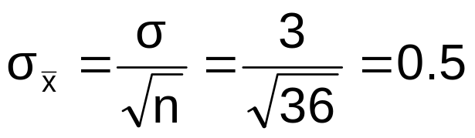
Example
(continued)
DCOVA
Solution:
Even if the population is not normally distributed, the central limit theorem can be used (n > 30)
… so the sampling distribution of is approximately normal
… with mean = 8
…and standard deviation

Slide 23
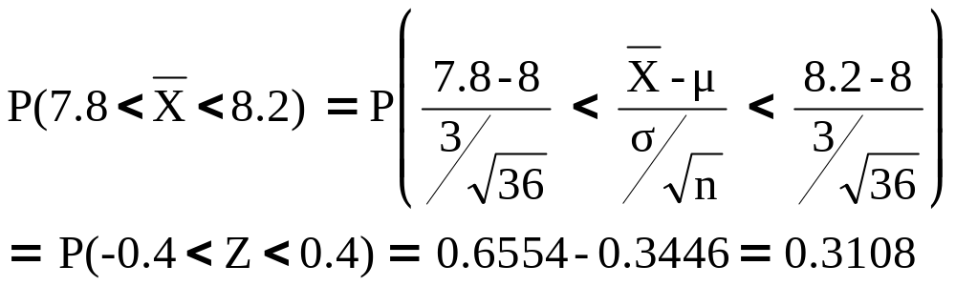




Example
(continued)
Solution (continued):
DCOVA
Population Distribution
Sampling Distribution
Standard Normal Distribution
?
?
?
?
?
?
?
?
?
?
Sample
Standardize
?
?
7.8 8.2
-0.4 0.4
Z
X

Slide 24
Population Proportions
DCOVA
π = the proportion of the population having
some characteristic
Sample proportion (p) provides an estimate
of π:
0 ≤ p ≤ 1
p is approximately distributed as a normal distribution when n is large
(assuming sampling with replacement from a finite population or without replacement from an infinite population)

Slide 25
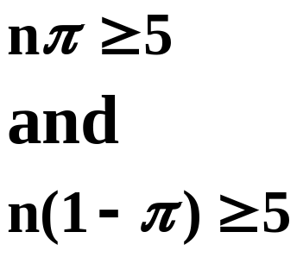
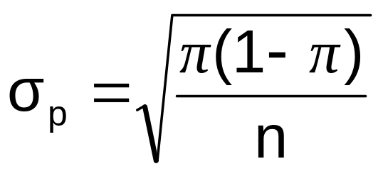
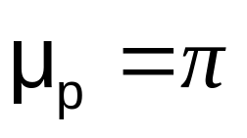
Sampling Distribution of p
DCOVA
Approximated by a
normal distribution if:
  where
  and
Sampling Distribution
P( p_{s})
.3
.2
.1
0
0 . 2 .4 .6 8 1
p
(where π = population proportion)

Slide 26
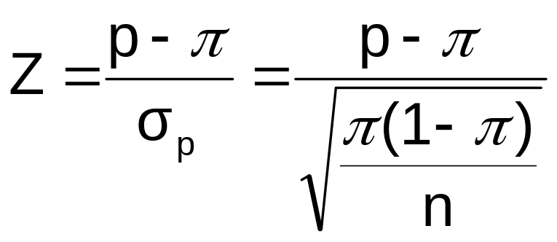
Z-Value for Proportions
DCOVA
Standardize p to a Z value with the formula:

Slide 27
Example
DCOVA
If the true proportion of voters who support Proposition A is π = 0.4, what is the probability that a sample of size 200 yields a sample proportion between 0.40 and 0.45?
i.e.: if π = 0.4 and n = 200, what is
P(0.40 ≤ p ≤ 0.45) ?

Slide 28
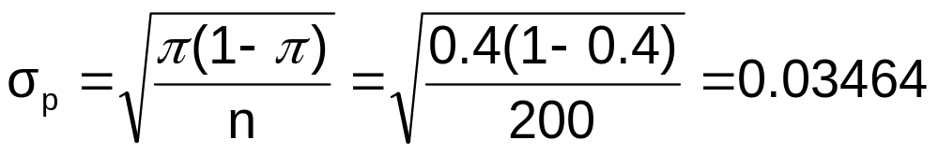

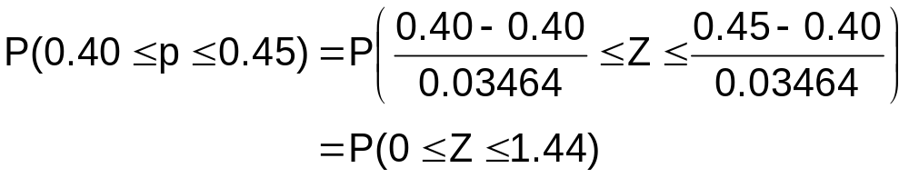
Example
(continued)
DCOVA
if π = 0.4 and n = 200, what is
P(0.40 ≤ p ≤ 0.45) ?
Find :
Convert to standardized normal:

Slide 29
Example
(continued)
DCOVA
if π = 0.4 and n = 200, what is
P(0.40 ≤ p ≤ 0.45) ?
Utilize the cumulative normal table:
P(0 ≤ Z ≤ 1.44) = 0.9251 – 0.5000 = 0.4251
Standardized
Normal Distribution
Sampling Distribution
0.4251
Standardize
0.40
0.45
p
0
1.44
Z

Slide 30
Chapter Summary
In this chapter we discussed:
The concept of a sampling distribution
Computing probabilities related to the sample mean and the sample proportion
The importance of the Central Limit Theorem

